Slide 1
Circuit Decomposition
for Hardware Efficient VQE
Team: QUasiCoders
Tianyi Peng¹, Linsen Li², Kaidong Peng², Yufeng Ye², Zhen Guo²
Department of Aeronautics and Astronautics, Massachusetts Institute of Technology
2. Department of Electrical Engineering and Computer Science, Massachusetts Institute of Technology

Slide 2
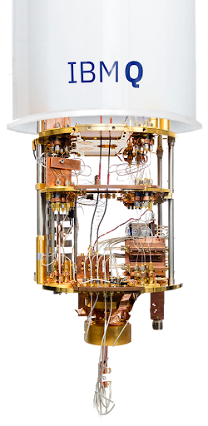
Outline
Circuit Decomposition for Hardware Efficient VQE
Introduction
Method and Principle
Result and Discussion
Conclusion
Acknowledgement and Supplementary Material

Slide 3
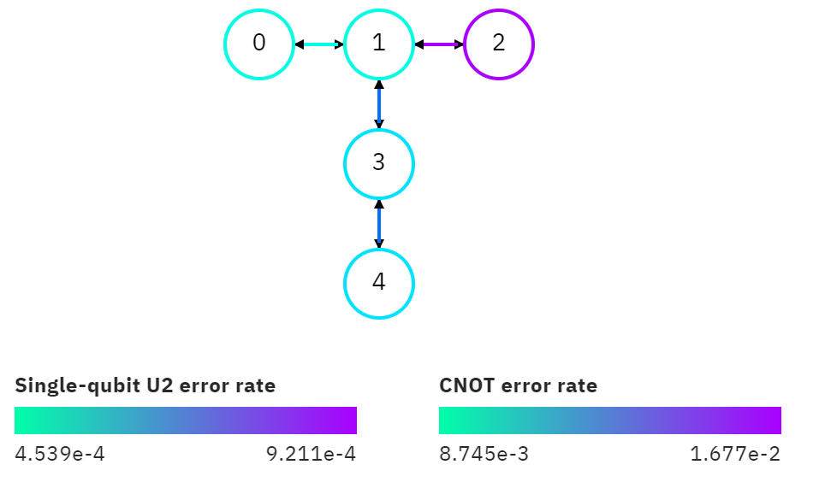
NISQ era: how to reduce the requirement for the number of qubits?
One of the most critical questions in the NISQ era
What if I want to run a 6-qubit circuit if I only have 5-qubit machines?
The most common T shape 5 qubit quantum computer in IBM Q Experience
Notes:
People are looking for the quantum computing application on the near term device. However, the near term device suffers from the low number of qubits and relatively high error rate in two qubit gate.
It is meaningful to reduce the number of qubits requirement for the quantum algorithm on the near term quantum computing device.
We realize the quantum circuit decomposition in IBM Q Experience to demo the idea of reducing the Qubit number requirement for realizing the correct quantum optimization with VQE solver.

Slide 4
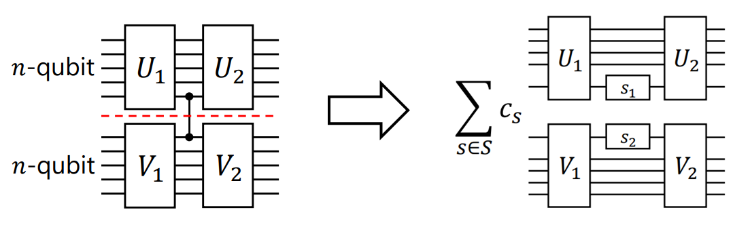
Circuit Decomposition
Decompose Non-local operation into single-qubit operations
Pros: Keep the depth same with less error for single-qubit gates

Slide 5
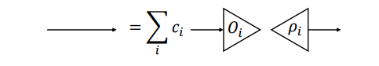
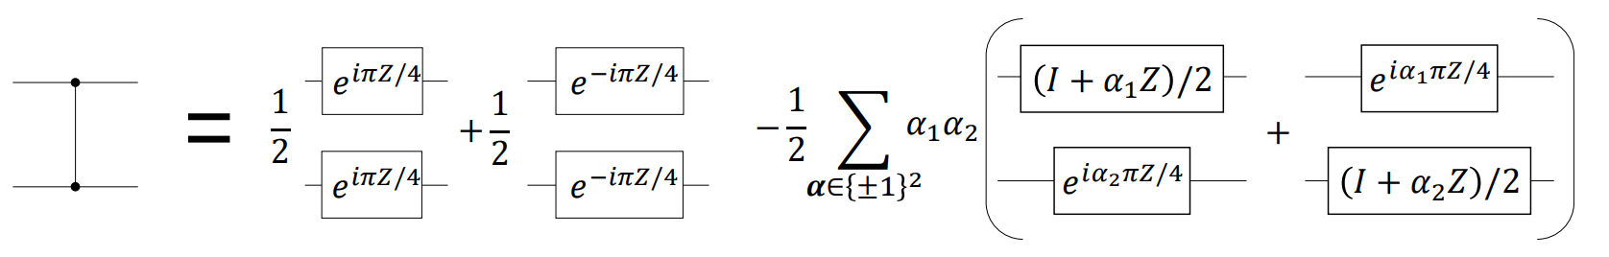
Principal of Circuit Decomposition
Virtual Qubit Communication
Peng, Tianyi, Aram Harrow, Maris Ozols, and Xiaodi Wu. "Simulating large quantum circuits on a small quantum computer." arXiv preprint arXiv:1904.00102 (2019).
Virtual Qubit Gate
Mitarai, Kosuke, and Keisuke Fujii. "Constructing a virtual two-qubit gate from single-qubit operations." arXiv preprint arXiv:1909.07534 (2019).

Slide 6
We propose to apply Circuit Decomposition to VQE
Optimization Problems
Hamiltonian Mapping
Variational-Quantum-Eigensolver
SPSA
Result Analysis
Optimized Result
Quantum Circuit Generation
Circuit Decomposition

Slide 7
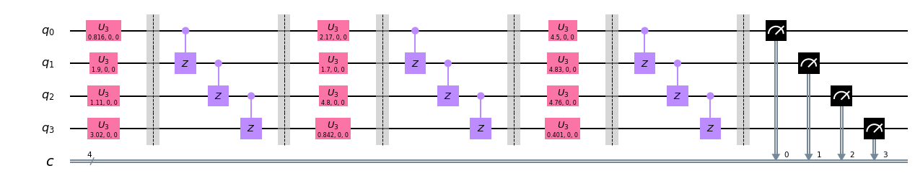
Hardware-Efficient VQE
A fixed circuit structure with a repetition of parameterized single qubit gates and entangled gates. Demonstrated for calculating the energy of small molecules.
Kandala, Abhinav, et al. "Hardware-efficient variational quantum eigensolver for small molecules and quantum magnets." Nature 549.7671 (2017): 242-246.
Example Circuit Diagram with N = 4, Depth = 3

Slide 8
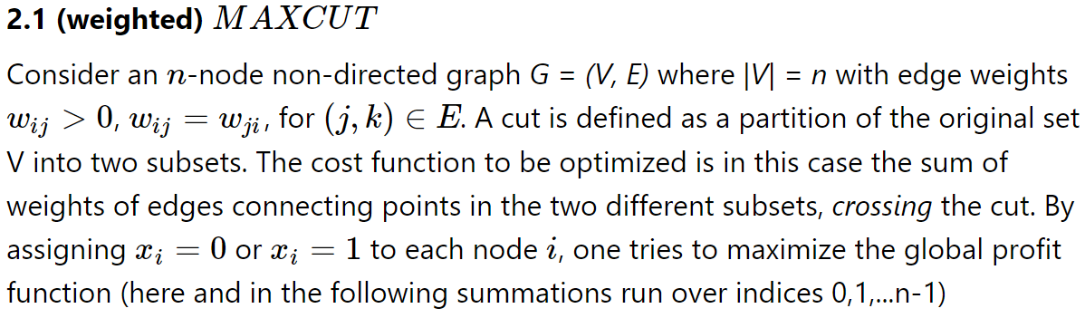
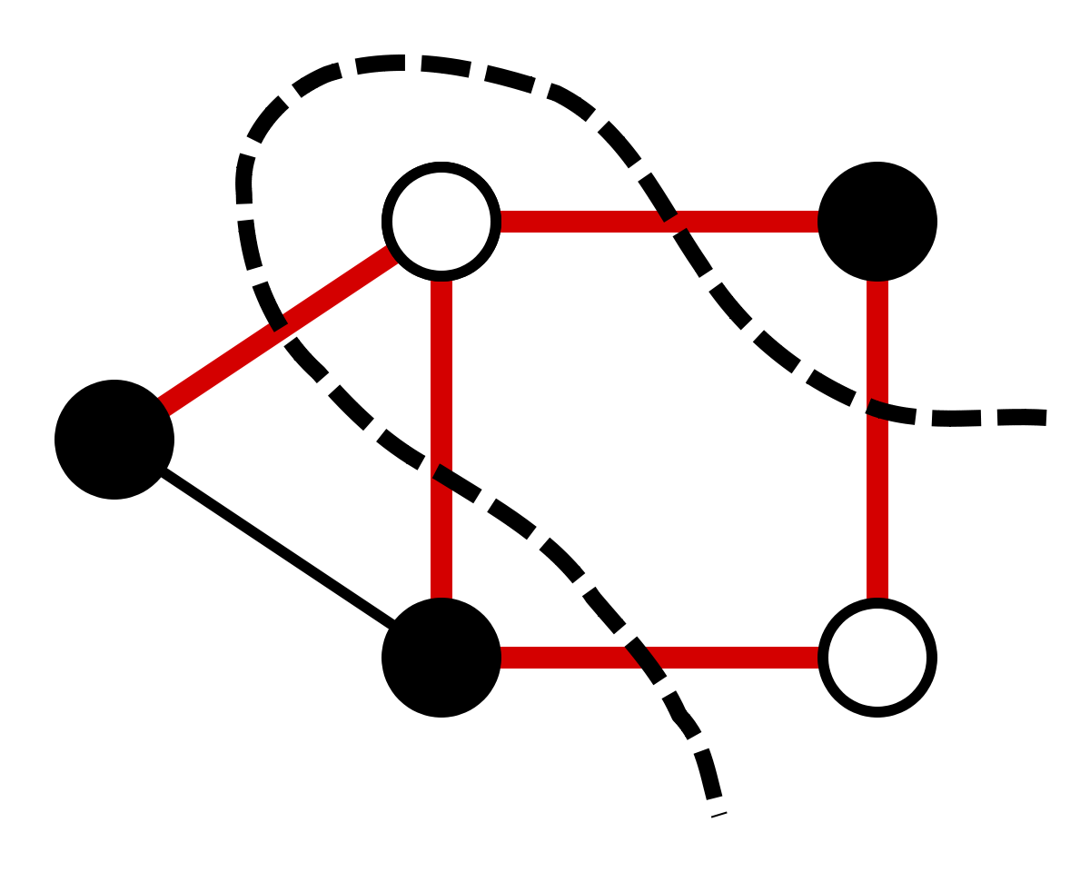
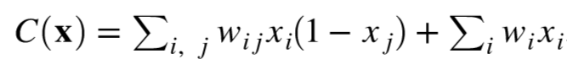
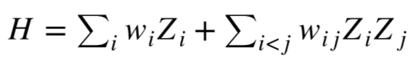
Example Application: Max-Cut Problem
The weighted Max-Cut problem is equivalent to minimizing the Ising Hamiltonian

Slide 9
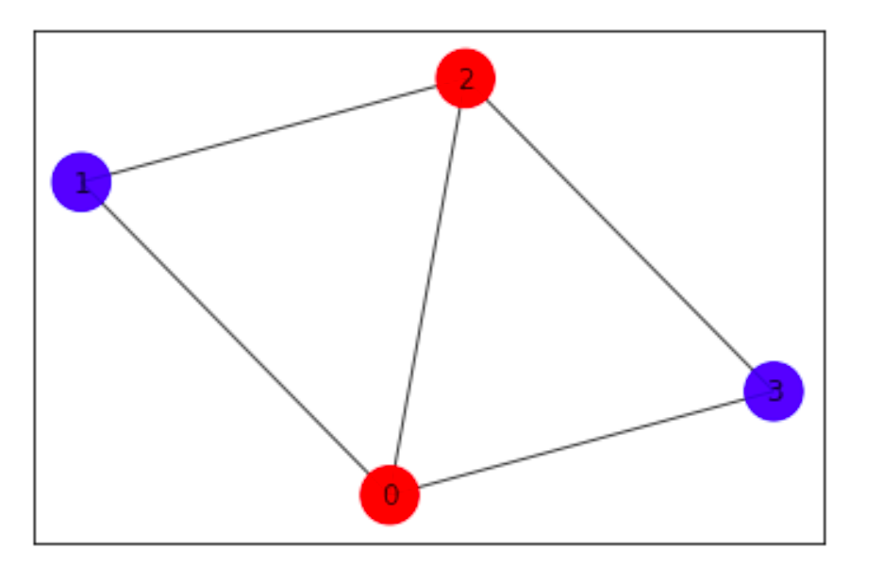
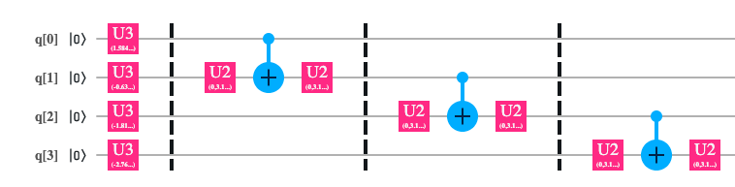
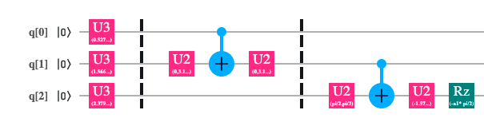
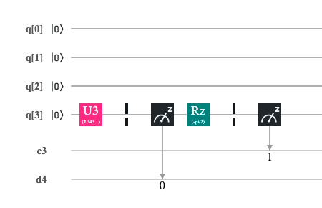
Experiments on IBM Q Chip
Depth = 1, N = 4
=∑

Slide 10
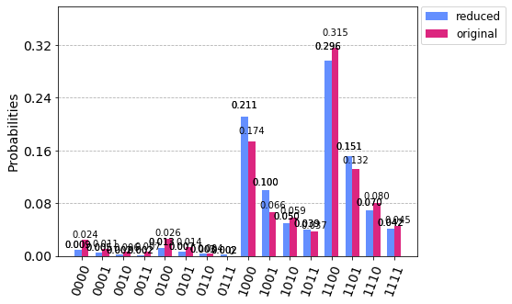
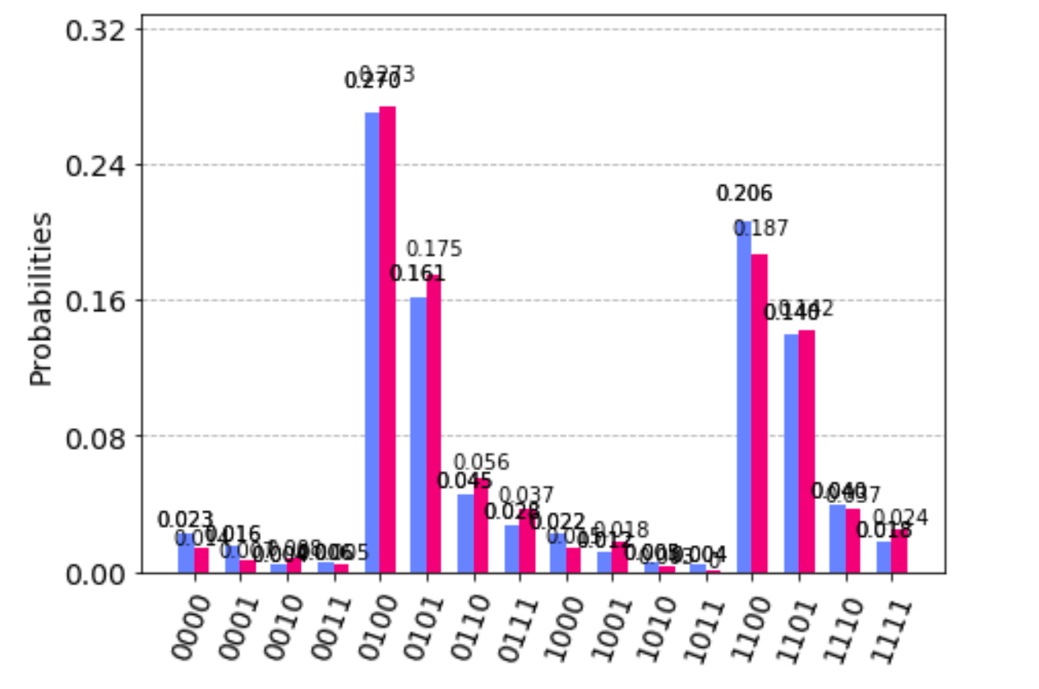
Experiments on IBM Q Chip
Random Variational Phase Parameters
Sample Distribution of original VQE circuit and
Combined Distribution of decomposed circuits

Slide 11
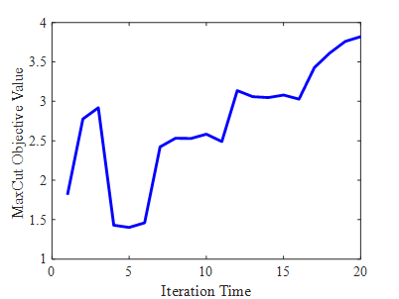
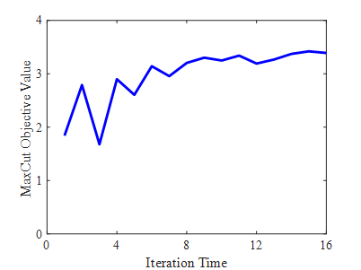
Experiments on IBM Q Chip
Both original circuit and decomposed circuits find the optimal cut
Original circuit (ibmq_vigo)
Decomposed circuits (ibmq_essex)

Slide 12
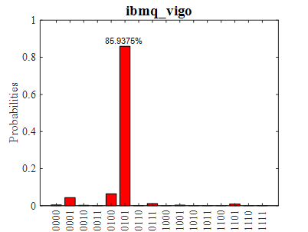
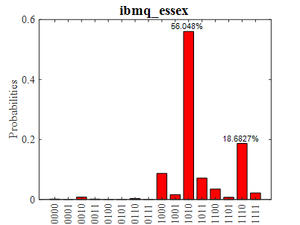
Experiments on IBM Q Chip
Original Circuit
Decomposed Circuits

Slide 13
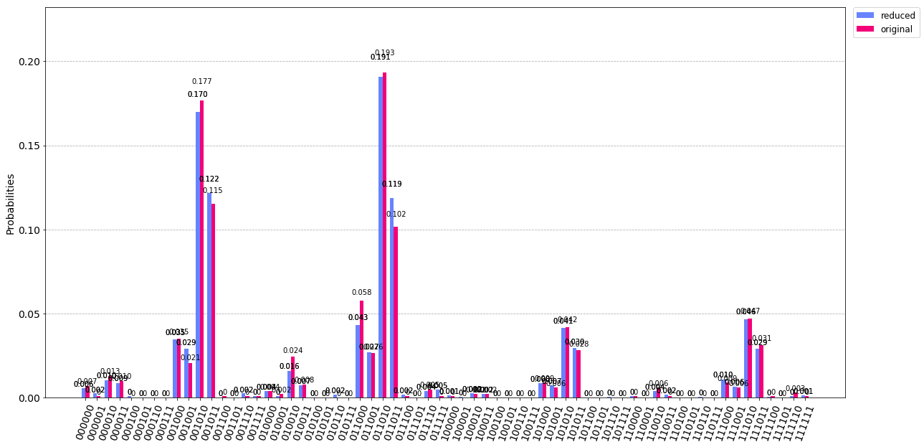
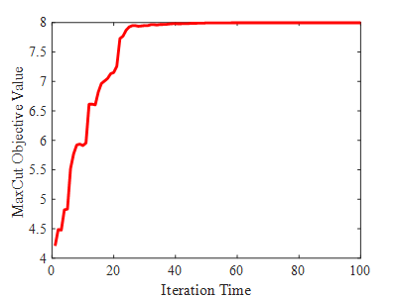
Simulation Result for 6-> 5 qubit circuit

Slide 14
Conclusion: We have tried circuit decomposition for VQE in NISQ era
We demonstrate 4-to-3 circuit decomposition on IBM chip
We demonstrate 6-to-5 circuit decomposition on IBM simulator
We demonstrate the effectiveness of hardware-efficient VQE circuits

Slide 15


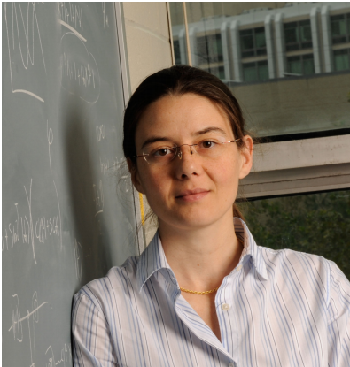




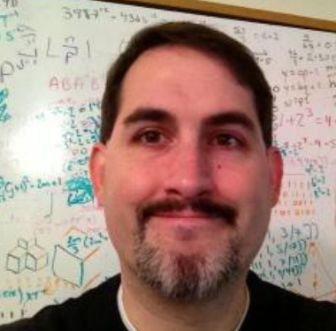

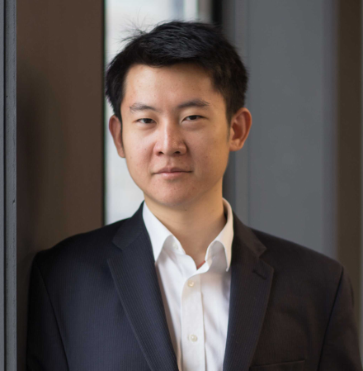

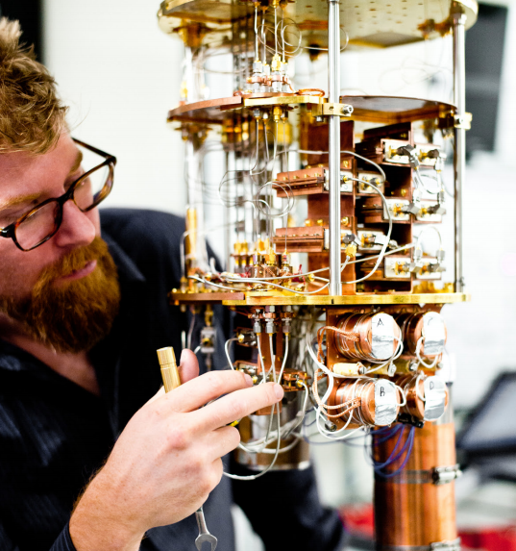


Acknowledgement
Thanks for iQuise taking so many effort to host the MIT Quantum Hackathon. Thanks for the sponsors’ kind support. Thanks for the arrival of the all the guests from their busy schedule.

Slide 16


Quantum
Community
Quantum computing is promising!!
Many companies and research labs are pushing the limit of the quantum computing.

Slide 17
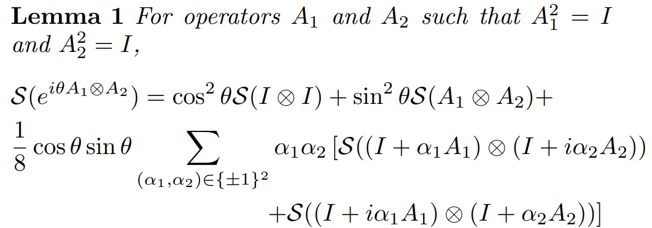
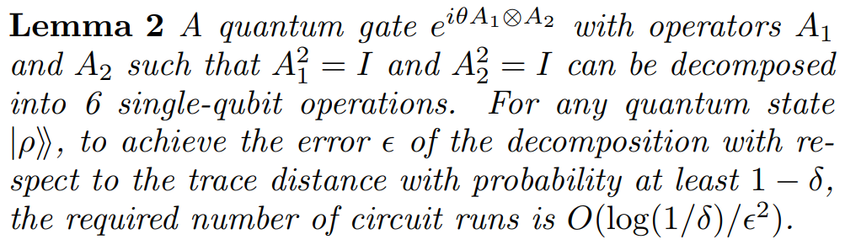
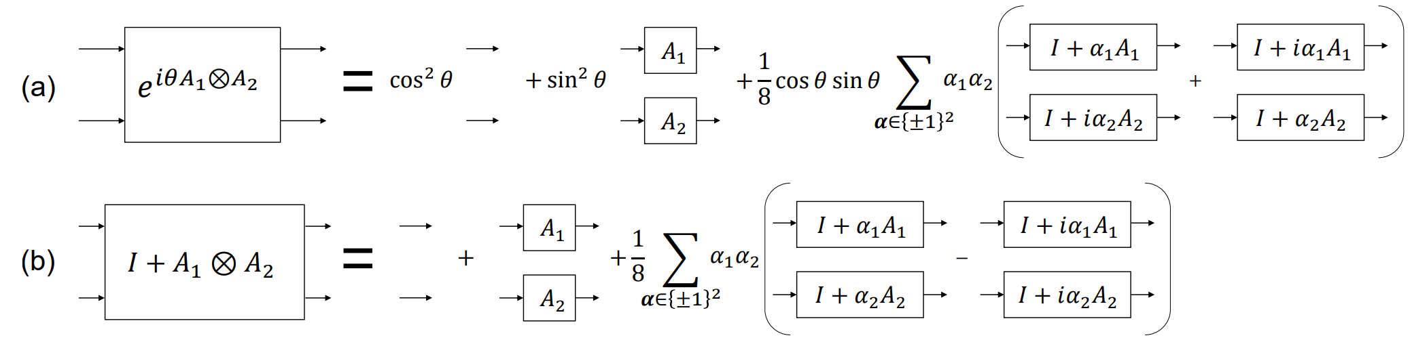
Supplementary Material

Slide 18
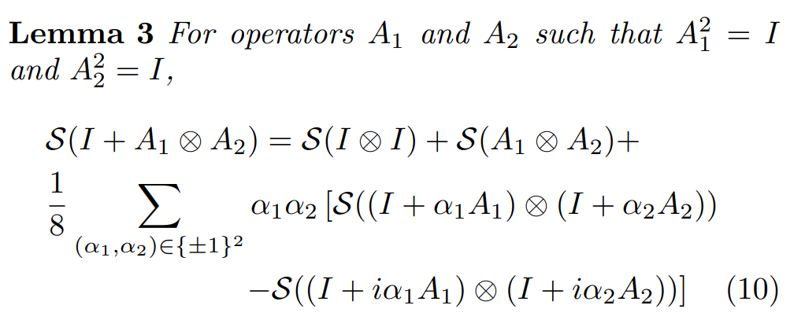
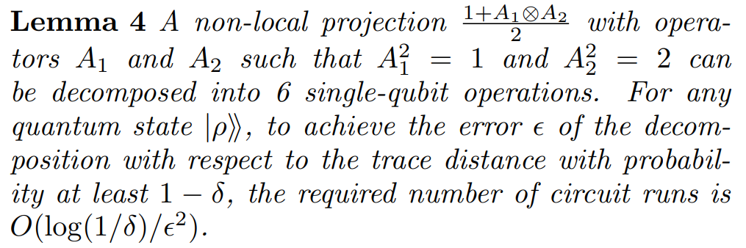
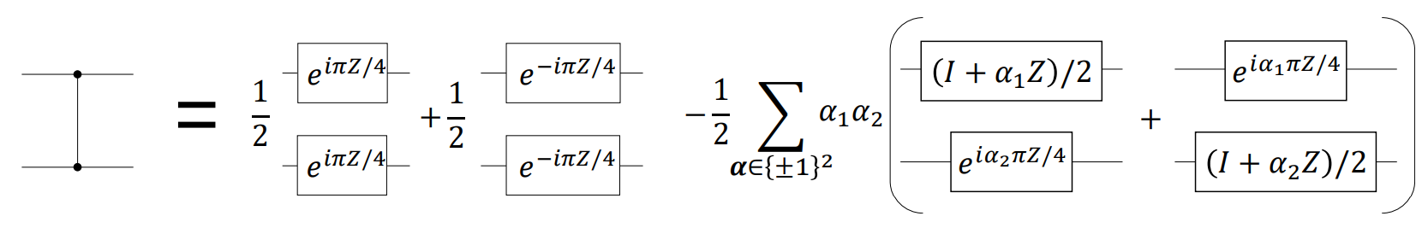
Supplementary Material

